Slide 1

Dover digital Hackathon challenge 2021
Hailstorm Prediction System
Phase 1 : Idea submission
Idea/Team name: Hailstorm Prediction System
Theme: Analytics

Slide 2
If your idea were a tweet
“Hailstorm Prediction System” analyses the historical data of hailstorms and help in visualizing trend of storm intensity versus state/city/month in the selected country.
Having clear idea on trend, users can predict the opportunity and can be prepared to capture the business on time without having delay in transferring hardware.

Slide 3
Problem statement
Name of the idea : Hailstorm Prediction System
Brief intro to idea : Collect, Analyze the history of hailstorm occurrence data and help VHSS business team to visualize the most impacted state (or) city (or) state in a particular month (or) city in a particular month (or) intensity across different months in a year for a selected state with very minimal effort and predict the business.
Opportunity (How will the world look like after implementing your idea) :
Helps VHSS Business team for placement of available rigs in right place in right time.
Predict next occurrence of hailstorm and plan the Rig moment accordingly.
Better understanding of business opportunities and plan the infrastructure management.
Help the organization to estimate potential revenue based on the statistical analysis of data.
Helpful in budgeting.
Inspiration (What do you think inspired you to think you choose this idea) :
Hassles observed in moving the hardware between places after the opportunity is identified.

Slide 4
Design
Core technology/ Architecture : Angular js, .Net 5.0, Power BI, Cosmos DB
List of problems, you are going to solve :
1. Unplanned movement of Rigs after getting the opportunity.
2. Not being able to estimate the potential revenue.
3. Not having clear idea on the necessity of building more Rigs
Who cares
This will be helpful for VHSS Business team
Why do they care :
Predict next occurrence of hailstorm and plan the Rig moment accordingly.
Helps in effective budgeting and realizing the potential revenue

Slide 5
Business Model of idea
Scenario: Currently, We have 1 Rig available. Where to position this and get maximum revenue in the month of April ?
Launch “Hailstorm Prediction System”
Select the country as ‘USA’
Go to ‘State’ tab and select month as ‘April’
Click on ‘5 yrs’ tab to analyze 5 years of data.
Click on the state which is severely affected as per the graph
User is navigated to ‘Location’ tab
Check for the ‘City’ with highest intensity from graph.
Place the Rig in the same City
Getting call form Organization
Set up the location
Start scanning

Slide 6
solution
1. Predict next occurrence of hailstorm and plan the Rig moment accordingly.
2. Effective estimate of potential revenue and increasing the business by building more infrastructure.
3. Clarity in Return Of Investment (ROI) with the help of statistical data analysis.

Slide 7
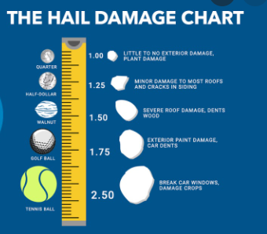
Research references
Storm Events Database | National Centers for Environmental Information (noaa.gov)
https://www.nssl.noaa.gov/education/svrwx101/hail/
https://www.almanac.com/hail-damage-measuring-hailstorm-intensity

Slide 8
Team participants
Name 1 : Kondapalli, Anjali
Name 2 : Thanikanti, Naga Dinesh
Name 3 : Kumar, Sravan
Name 4 : N, Rajagopal
Name 5 : Achyuth, Payani
Name 6 : Meher, Dagindra
Mentors:
Satish Venkatesalu
Mike Johannes

